Slide 1
TRAVEL Agent
AICTE IBM PROJECT
Presented By:
Student name : Palivela Kundana Prabha
College Name & Department : Aditya Womens Degree College, Kakinada from BSC DATA SCIENCE DEPT.

Slide 2
OUTLINE
Problem Statement
Technology used
Wow factor
End users
Result
Conclusion
Git-hub Link
Future scope
IBM Certifications

Slide 3
Problem Statement :5
Travel planning can be stressful and time-consuming, with fragmented sources for flights, hotels, weather, and destinations.
Proposed Solution:
An AI-powered Travel Planner Agent that:
Uses real-time data to suggest destinations
Builds smart itineraries
Recommends travel and accommodation options
Integrates weather forecasts, maps, and local guides
Understands user preferences, budgets, and constraints
Offers live alerts and on-the-go schedule optimization
Transforming complex travel planning into a smooth and personalized experience.

Slide 4
Technology used
IBM Cloud Lite Services
IBM Watsonx AI Studio & Runtime
IBM Granite Foundation Model
Natural Language Processing (NLP)
Real-time API Integration (maps, weather, booking sites)
User Profiling & Preference Matching
Backend orchestration using serverless cloud functions

Slide 5
Wow factors
Hyper-Personalized Itineraries: Based on travel history, budget, interests, and seasonality
Real-Time Data Integration: Flights, weather, local events, accommodation
Voice/Text Interaction: Users can plan using natural conversation
Smart Rescheduling: Alerts and re-plans in real-time for delays or cancellations
Cost Optimization Engine: Recommends budget-friendly options dynamically
Local Guide AI: Recommends top places, hidden gems, food spots
Multi-lingual Interface: Assists travelers in their native language

Slide 6
End users
Individual Travelers – Solo, family, or group travel planning
Travel Agencies – Automate and personalize planning for clients
Business Travelers – Efficient, schedule-optimized travel solutions
Tour Operators – Dynamic itinerary creation and adjustments
Students and Budget Travelers – Optimize cost and experience

Slide 7
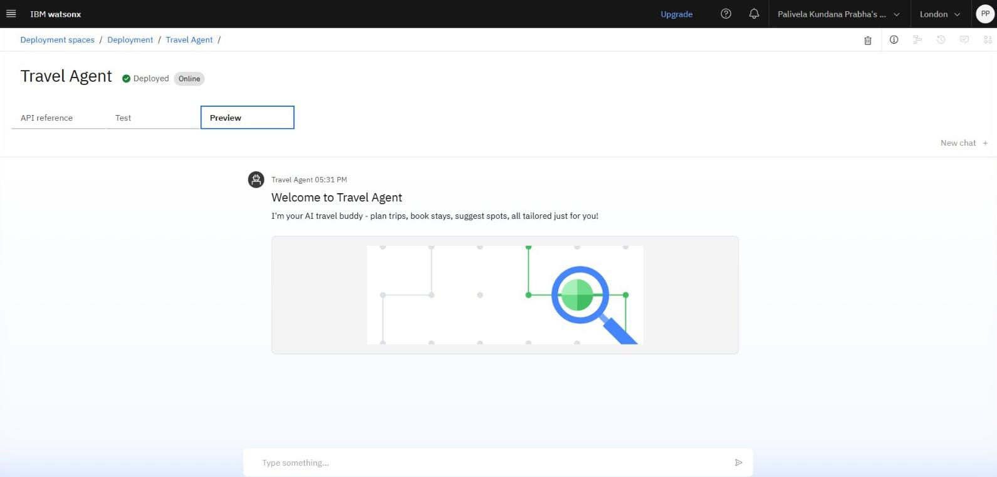
Results

Slide 8
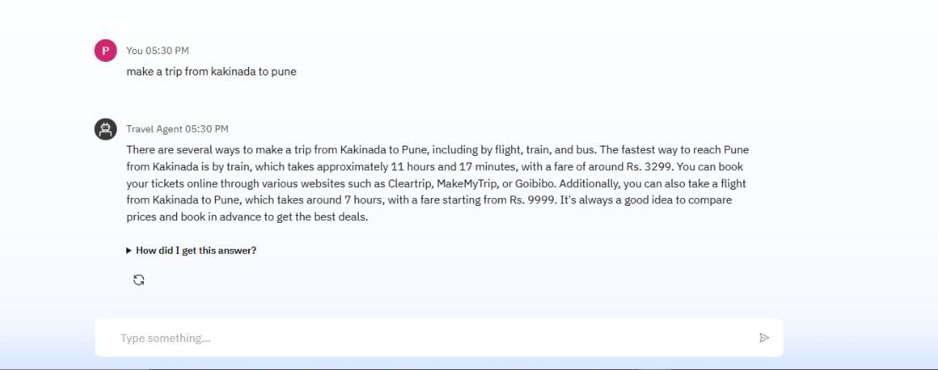
Results

Slide 9
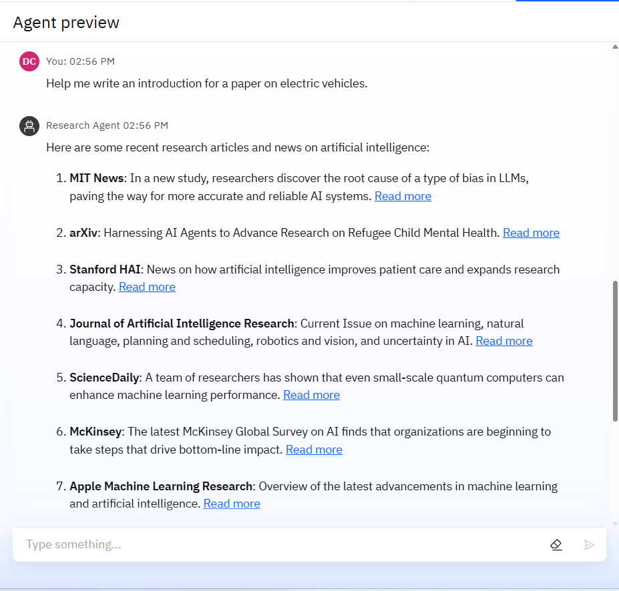
Results

Slide 10
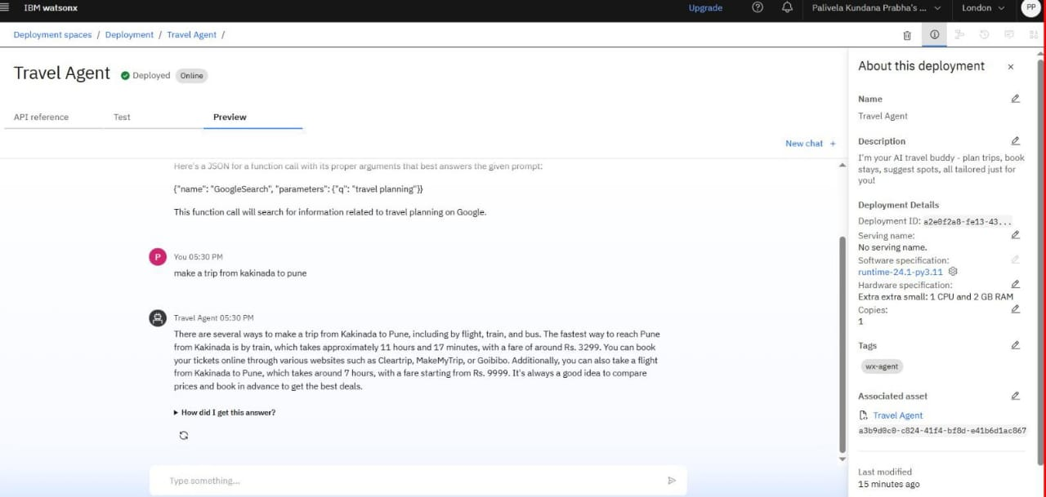
Results
Deployed AI Agent

Slide 11
Conclusion
The Travel Planner Agent simplifies and personalizes travel planning using IBM’s powerful AI tools.
It provides real-time, context-aware, and budget-friendly solutions—making travel stress-free and efficient.
IBM Granite adds natural understanding to the interaction, while Cloud Lite ensures scalability and availability.

Slide 12
GitHub Link
https://github.com/Kundana22dotcom/Travel_Agent.git

Slide 13
Future scope
Integration with travel insurance and visa advisory systems
Advanced AI-based travel recommendation system using past travel data
Sustainability filter (eco-friendly accommodations and transport)
Integration with Augmented Reality for local experiences
Partnership with booking platforms (Expedia, Skyscanner, etc.)

Slide 14
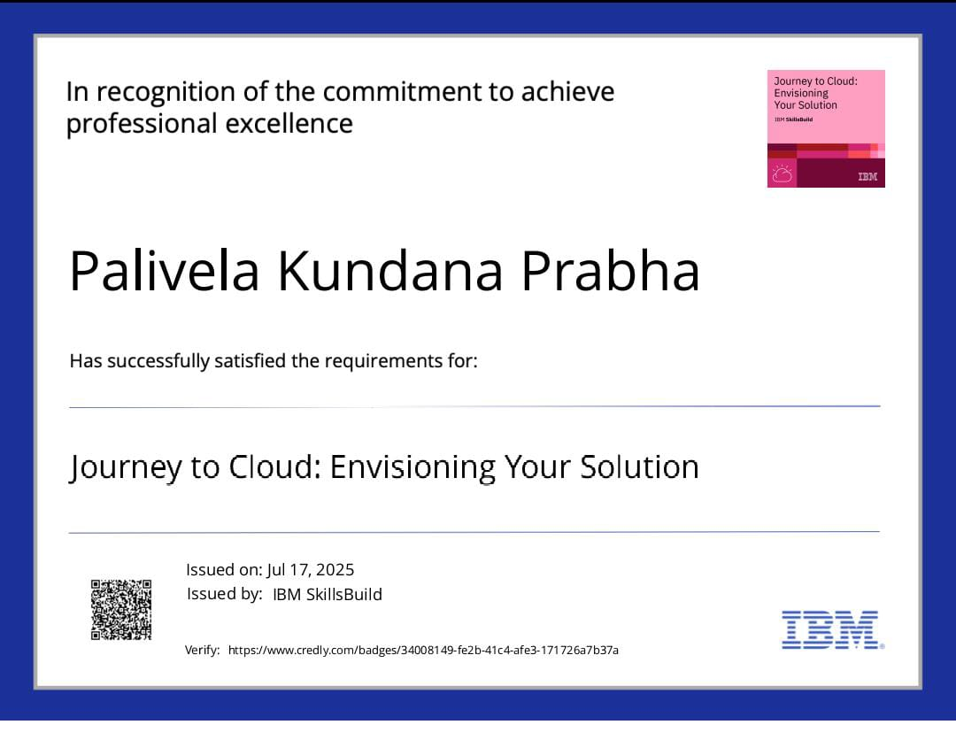
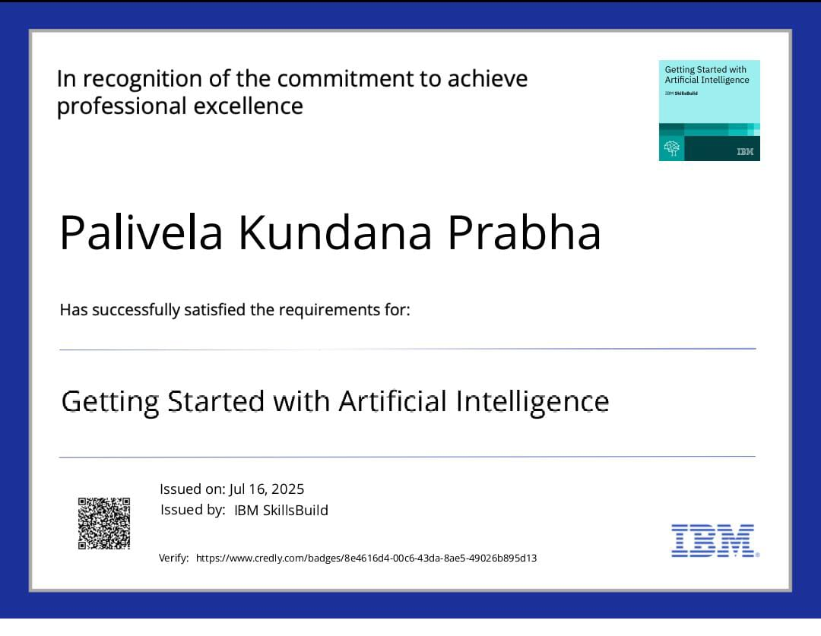
IBM Certifications

Slide 15
THANK YOU

